Slide 1
A BRIEF INTRODUCTION TO THE HISTORICAL DEVELOPMENT OF FINANCIAL THEORY AND PRACTICE
By Wenlong (Will) Zhao
prepared for RiskLab at UofT
Notes:
Last updated 5.Jul.2020.

Slide 2
DISCLAIMER
NO INVESTMENT ADVICE
The presentation and content is for informational purposes only, you should not construe any such information or other material as legal, tax, investment, financial, or other advice. Nothing contained in this presentation constitutes a solicitation, recommendation, endorsement, or offer by any third-party service provider to buy or sell any securities or other financial instruments in this or in in any other jurisdiction in which such solicitation or offer would be unlawful under the securities laws of such jurisdiction.
All content in this presentation is information of a general nature and does not address the circumstances of any particular individual or entity. Nothing in this presentation constitutes professional and/or financial advice, nor does any information in this presentation constitute a comprehensive or complete statement of the matters discussed or the law relating thereto. University of Toronto, RiskLab and I am not a fiduciary by virtue of any person’s use of or access to the presentation. You alone assume the sole responsibility of evaluating the merits and risks associated with the use of any information or other Content in this presentation before making any decisions based on such information or other Content. In exchange for viewing this presentation, you agree not to hold me, my affiliates or any third party service provider liable for any possible claim for damages arising from any decision you make based on information or other Content made available to you through the presentation.
THIRD PARTY
As a convenience to you, this presentation provides hyperlinks to web sites operated by third parties. When you select these hyperlinks you will be leaving the presentation. Because University of Toronto, RiskLab and I have no control over such sites or their content, University of Toronto, RiskLab and I am not responsible for the availability of such external sites or their content, and do not adopt, endorse or nor is responsible or liable for any such sites or content, including advertising, products or other materials, on or available through such sites or resources. Other web sites may provide links to this presentation with or without my authorization. I shall not be responsible or liable for any links from those sites to this presentation, or for any content, advertising, products or other materials available on or through such other sites, or any loss or damages incurred in connection therewith.
Your use of third party web sites and content, including without limitation, your use of any information, data, advertising, products, or other materials on or available through such web sites, is at your own risk and is subject to their terms of use.
NO RELIANCE
Accordingly, University of Toronto, RiskLab and I will not be liable, whether in contract, tort (including negligence) or otherwise, in respect of any damage, expense or other loss you may suffer arising out of such information or any reliance you may place upon such information. Any arrangements between you and any third party contacted via the Website are at your sole risk.
LIMITATION OF LIABILITY
Your exclusive remedy for dissatisfaction with this presentation and content is to stop using them. University of toronto, risklad and I am not liable for any direct, indirect, incidental, consequential, special or punitive damages, under any theory of liability, including without limitation, damages for loss of profits, use, data, or loss of other intangibles. In particular, and without limitation, university of toronto, risklad and I will not be liable for damages of any kind resulting from your use of or inability to use the site or content.
While I try to maintain the integrity and security of the presentation or content, I do not guarantee that the presentation or content is or remains secure, complete or correct, or that access to the presentation or content will be uninterrupted or error free. The presentation and content may include inaccuracies, errors and materials that violate or conflict with these Terms.
LIMITED RIGHT OF USE/OWNERSHIP OF CONTENT
You are permitted to use the presentation for your personal, non-commercial use only. The presentation and content are and shall remain the property of me or the original copyright owners, and is protected by copyright, trademark, patent, and/or other intellectual property, proprietary, work product rights and laws. You may use the presentation for your personal, noncommercial use, provided that you keep intact all copyright, trademark, patent and other proprietary notices. Except as expressly authorized in advance by me in writing, you agree not to reproduce, modify or create derivative works based on, rent, lease, loan, sell, distribute, publish, publicly perform or display, reverse engineer, de-compile or dissemble, all or any part of the presentation or content. If you are one of the copyright owners and wish your work to be taken off from this presentation, please contact me at wenlong.zhao@outlook.com with a description of the material(s) at issue.

Slide 3
PURPOSES
Introduction/Refreshment
Historical Development
Theoretical Foundation
A Bigger picture and beyond
No Math

Slide 4
ROAD MAP
Belief | Believer | Philosophy | Ancient | Analysis | Technician | Strategy
 |  |  | Old |  | Fundamentalist
 |  |  | Modern |  | Portfolio Theorist
 | Non-Believer |  | New |  | Behavioralist
Belief
EMH Believer
Non-Believer
Philosophy
Ancient
Old
Modern
New
Analysis
Technician
Fundamentalist
Portfolio Theorist
Behavioralist
Strategy
Conclusion

Slide 5
BELIEF
Efficient Market Hypothesis (EMH) Believer
Non-Believer
Belief | Believer | Philosophy | Ancient | Analysis | Technician | Strategy
 |  |  | Old |  | Fundamentalist
 |  |  | Modern |  | Portfolio Theorist
 | Non-Believer |  | New |  | Behavioralist

Slide 6
WHAT DO YOU BELIEVE?
Investment is a(n)
Myth (e.g. astrology, numerology, Alchemy)
Art (e.g. painting, sculpture)
Science* (e.g. astronomy, physics)
Mixture
Belief | Believer | Philosophy | Ancient | Analysis | Technician | Strategy
 |  |  | Old |  | Fundamentalist
 |  |  | Modern |  | Portfolio Theorist
 | Non-Believer |  | New |  | Behavioralist
Notes:
*How about the observer effect in quantum physics?

Slide 7
EMH
Eugene Fama*
Efficient Capital Markets: A Review of Theory and Empirical Work (1970)
Categorized empirical tests of efficiency into "weak-form", "semi-strong-form", and "strong-form" tests.
 |  | Market Prices Reflect:
 |  | Past Market Data | Public Information | Private Information
Forms | Weak Form | Yes | Not required | Not required
 | Semi-Strong Form | Yes | Yes | Not required
 | Strong Form | Yes | Yes | Yes
Source: https://www.cfainstitute.org
Belief | Believer | Philosophy | Ancient | Analysis | Technician | Strategy
 |  |  | Old |  | Fundamentalist
 |  |  | Modern |  | Portfolio Theorist
 | Non-Believer |  | New |  | Behavioralist
Notes:
*The hypothesis does not say every participant in the markets has to be rational, but on average, they are rational. Several arguments have been made to suggest that even if there are a fair amount of irrational investors, the market can still be rational. For example, if “irrational investors have different beliefs” then “the net effect is might be that these investors cancel each other out” (Jordan, Miller, & Yuce, 2008).
If “their collective irrationality does not balance out”, rational arbitrageurs will take the opportunity and thus, markets will reach equilibrium again (Jordan, Miller, & Yuce, 2008). Fama (1970) also argues that “naïve investors” are price-protected and will not be exploited by.

Slide 8
MARKET ANOMALIES
Anomaly | Type | Observation
January effect | Calendar based | Returns on January is significantly higher than the rest of the months of the year
Holiday effect | Calendar based | Return on stocks in the day prior to market holiday tend to be higher than other days
Momentum | Technical | Observer tendency for rising stock prices to rise further, and falling prices to keep falling
Dividend Yield | Fundamental | High yielding stocks tend to outperform.
Size effect | Other | Small-cap companies outperform large-cap companies on a risk-adjusted base.
Post- Announcement Drift (PAD) | Other | Price changes tend to persist after initial announcements.
Rational Choice Theory vs. Rational Expectation Hypothesis (REH)*
The Assaults/Anomalies
Source: http://www.investorhome.com/anomaly.htm
Belief | Believer | Philosophy | Ancient | Analysis | Technician | Strategy
 |  |  | Old |  | Fundamentalist
 |  |  | Modern |  | Portfolio Theorist
 | Non-Believer |  | New |  | Behavioralist
Notes:
“it is important to distinguish the rational-expectations assumption from assumptions of individual rationality and to note that the first does not imply the latter. Rational expectations is an assumption of aggregate consistency in dynamic models. In contrast, rational choice theory studies individual decision making and is used extensively in, among others, game theory and contract theory.” - https://en.wikipedia.org/wiki/Rational_expectations

Slide 9
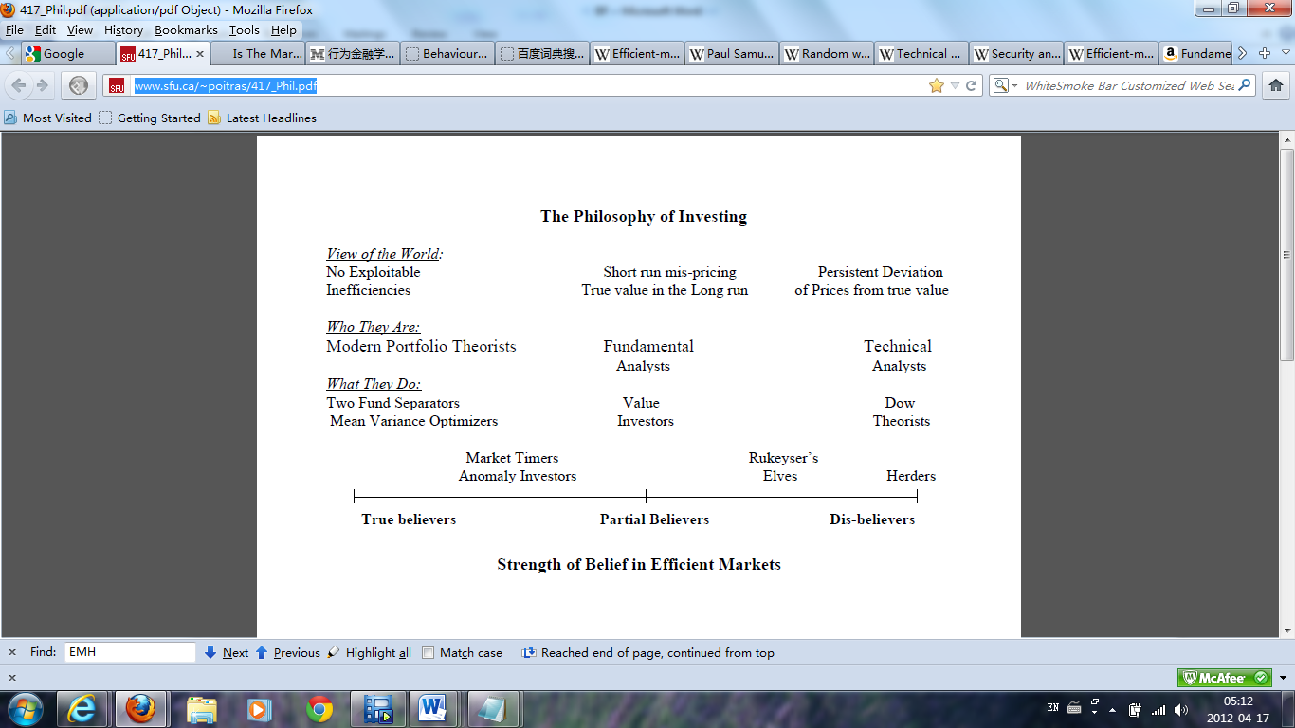
INVESTMENT PHILOSOPHY SPECTRUM
Source: Poitras, Geoffery (2010). Valuation of Equity Securities. Singapore: World Scientific Publishing, p. 28
Belief | Believer | Philosophy | Ancient | Analysis | Technician | Strategy
 |  |  | Old |  | Fundamentalist
 |  |  | Modern |  | Portfolio Theorist
 | Non-Believer |  | New |  | Behavioralist

Slide 10
PHILOSOPHY
Ancient
Old
Modern
New
Belief | Believer | Philosophy | Ancient | Analysis | Technician | Strategy
 |  |  | Old |  | Fundamentalist
 |  |  | Modern |  | Portfolio Theorist
 | Non-Believer |  | New |  | Behavioralist

Slide 11
ANCIENT FINANCE
Joseph de la Vega* (1650 – 1692)
Confusion de Confusiones (1688)
The oldest book ever written on the stock exchange business
Trading rule of thumb
Homma Munehisa (1724 - 1803)
Future and Forwards on Japanese rice market
Father of Candlestick Charts
The Fountain of Gold - The Three Monkey Record of Money (1755)
The first book on market psychology
Belief | Believer | Philosophy | Ancient | Analysis | Technician | Strategy
 |  |  | Old |  | Fundamentalist
 |  |  | Modern |  | Portfolio Theorist
 | Non-Believer |  | New |  | Behavioralist
Notes:
*wikipedia: Joseph Penso de la Vega, best known as Josseph de la Vega (ca.1650, Espejo, Spain — November 13, 1692, Amsterdam, Netherlands), was a successful spanish Jewish merchant, poet, and philanthropist residing in 17th century Amsterdam.
Penso also came up with four basic rules of the share market that are still of the greatest relevance today:
The first rule in speculation is: Never advise anyone to buy or sell shares. Where guessing correctly is a form of witchcraft, counsel cannot be put on airs.
The second rule: Accept both your profits and regrets. It is best to seize what comes to hand when it comes, and not expect that your good fortune and the favorable circumstances will last.
The third rule: Profit in the share market is goblin treasure: at one moment, it is carbuncles, the next it is coal; one moment diamonds, and the next pebbles. Sometimes, they are the tears that Aurora leaves on the sweet morning's grass, at other times, they are just tears.
The fourth rule: He who wishes to become rich from this game must have both money and patience.

Slide 12
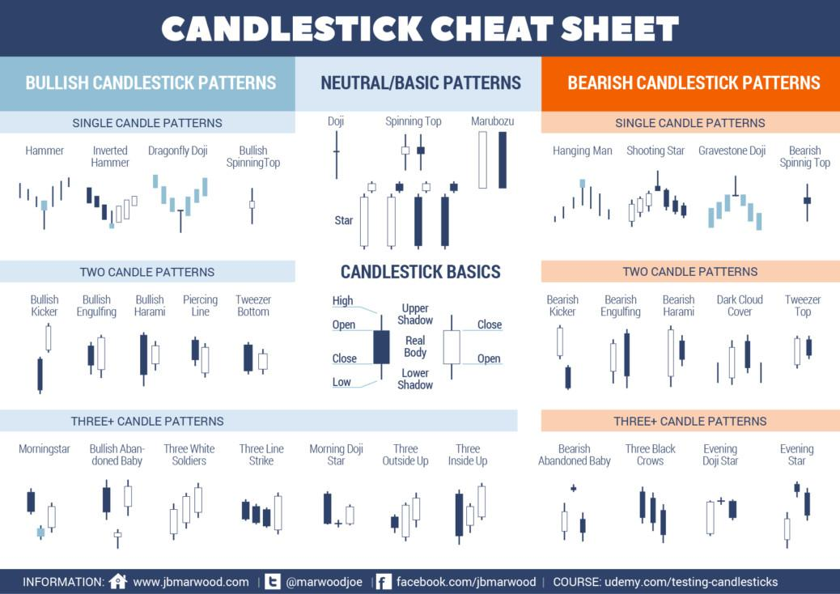
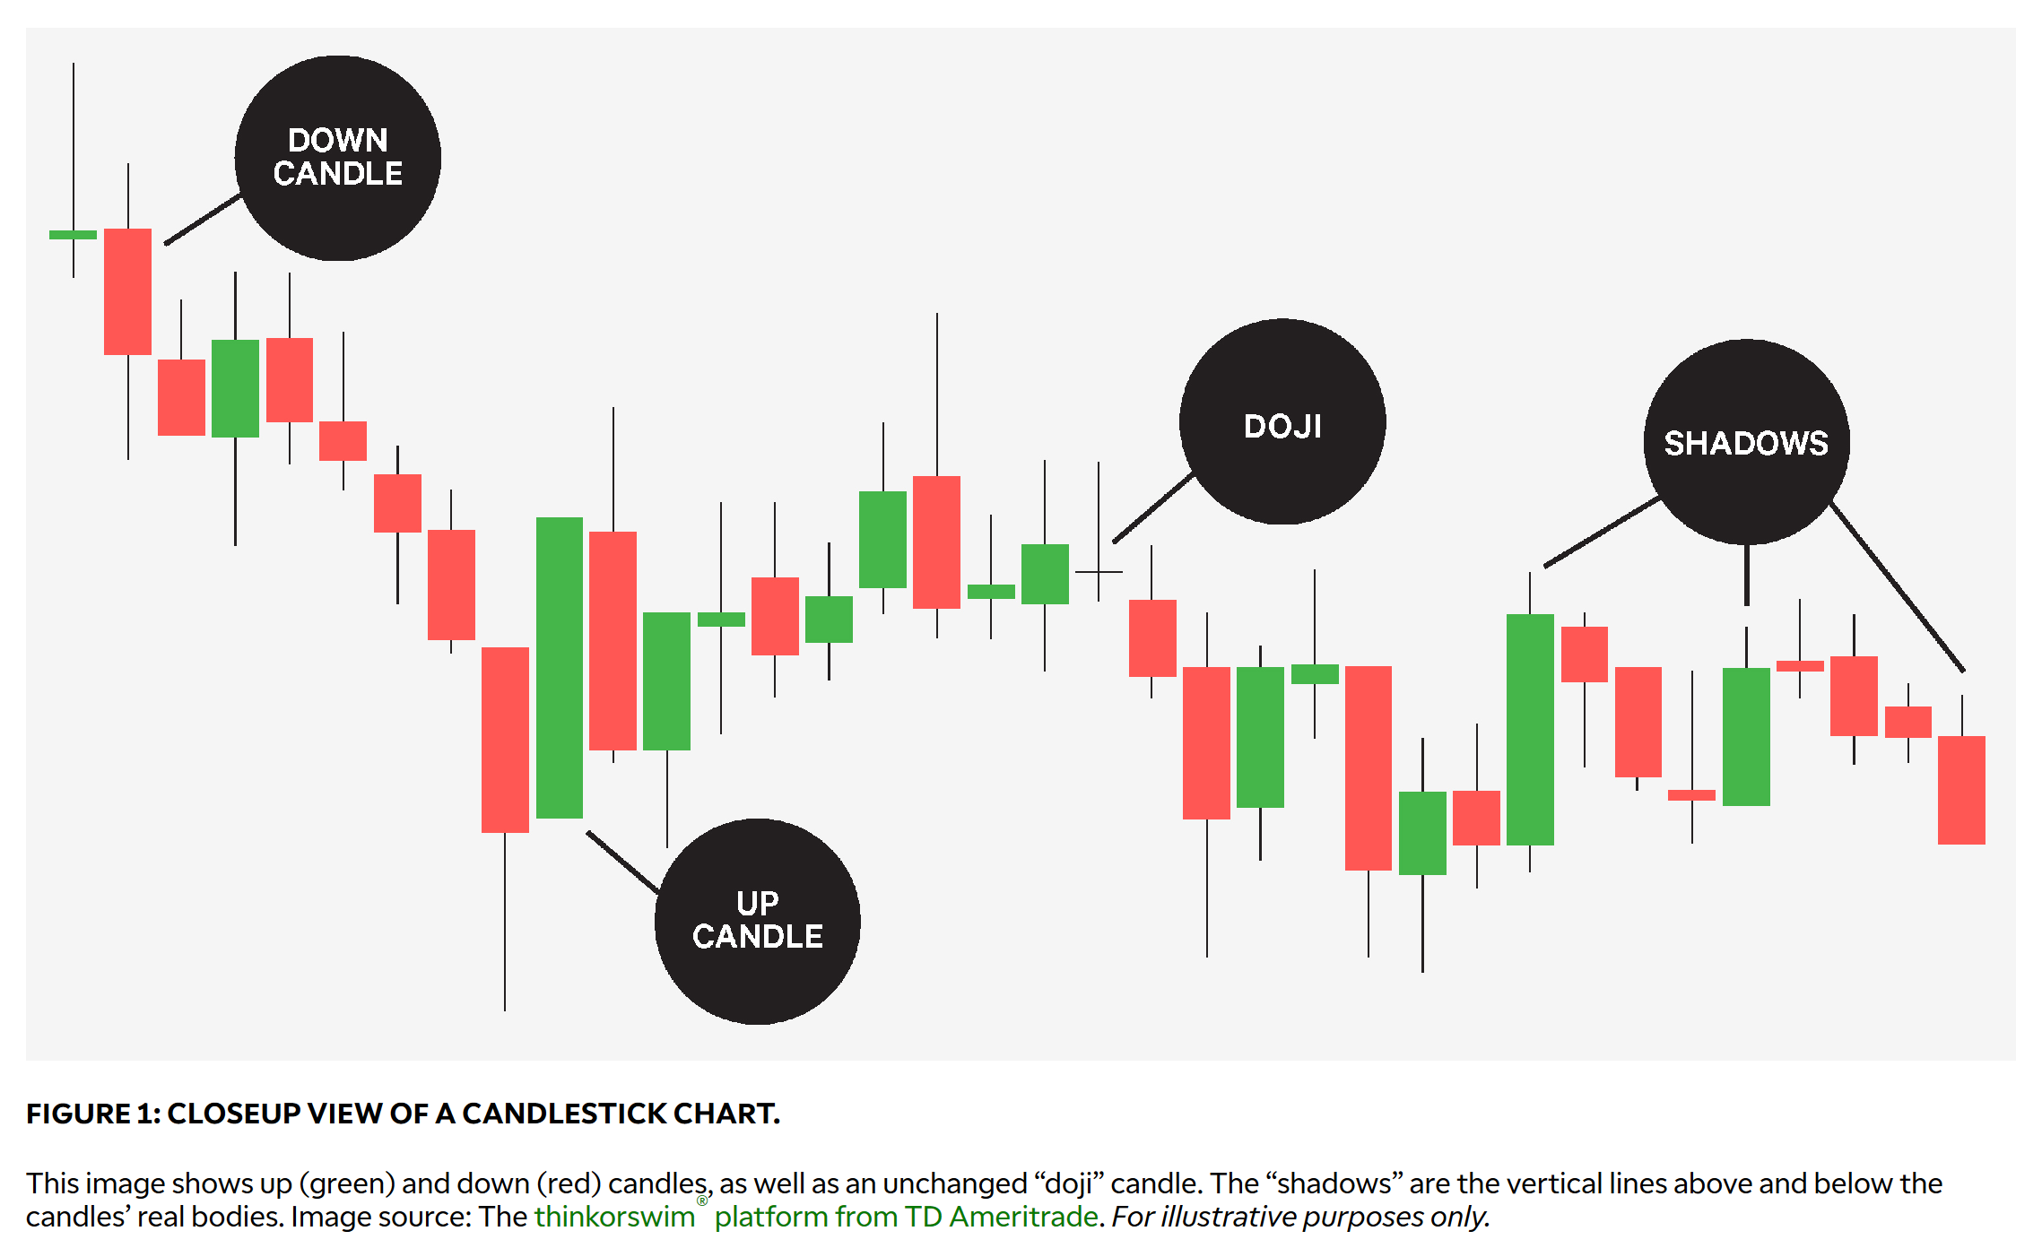
CANDLESTICKS CHARTS
Belief | Believer | Philosophy | Ancient | Analysis | Technician | Strategy
 |  |  | Old |  | Fundamentalist
 |  |  | Modern |  | Portfolio Theorist
 | Non-Believer |  | New |  | Behavioralist

Slide 13
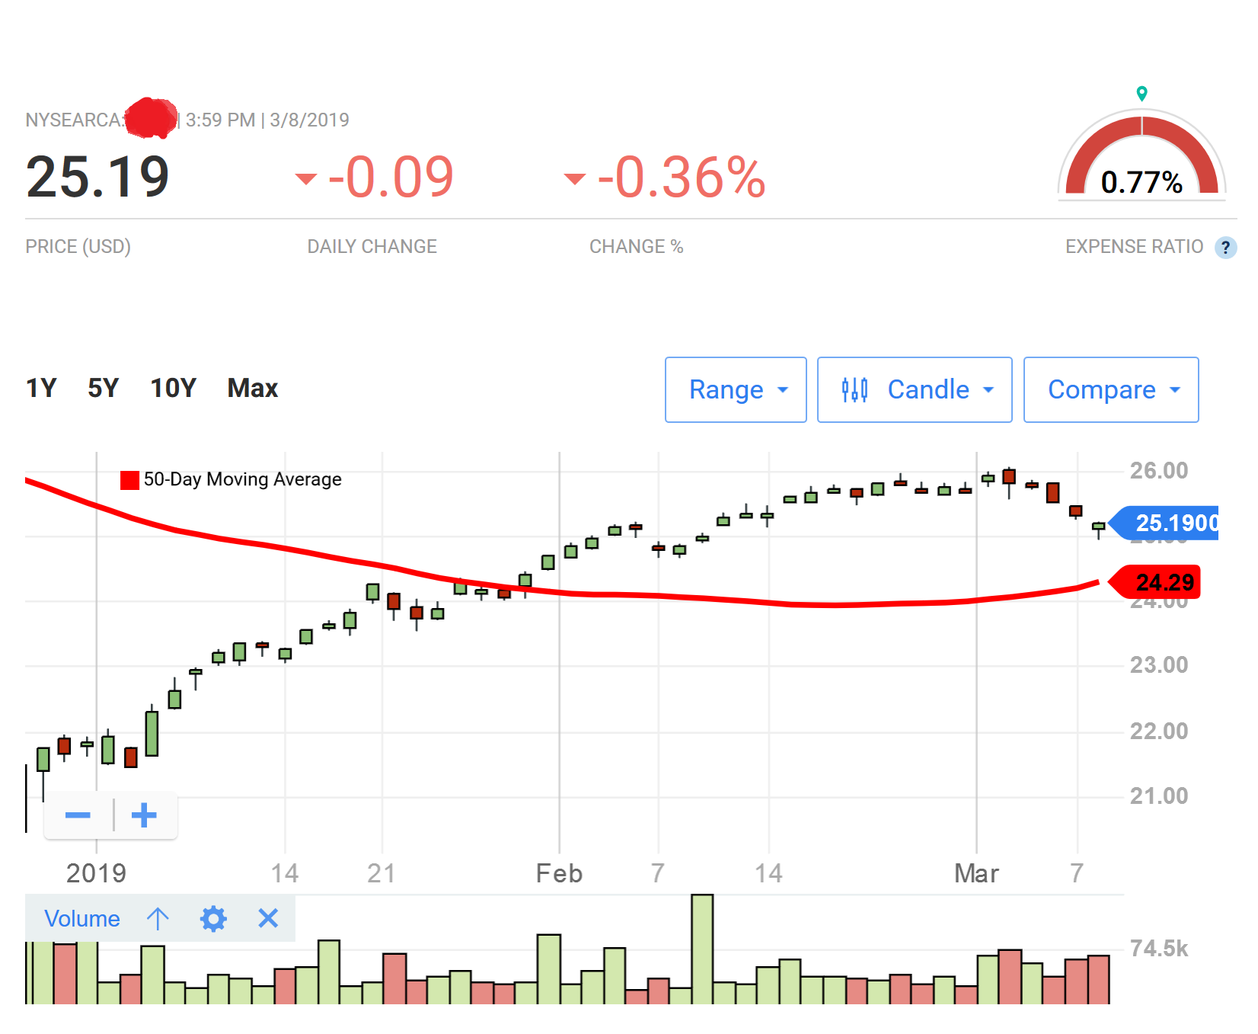
THE GUESSING GAME
Chart Credit: https://money.usnews.com
Belief | Believer | Philosophy | Ancient | Analysis | Technician | Strategy
 |  |  | Old |  | Fundamentalist
 |  |  | Modern |  | Portfolio Theorist
 | Non-Believer |  | New |  | Behavioralist

Slide 14
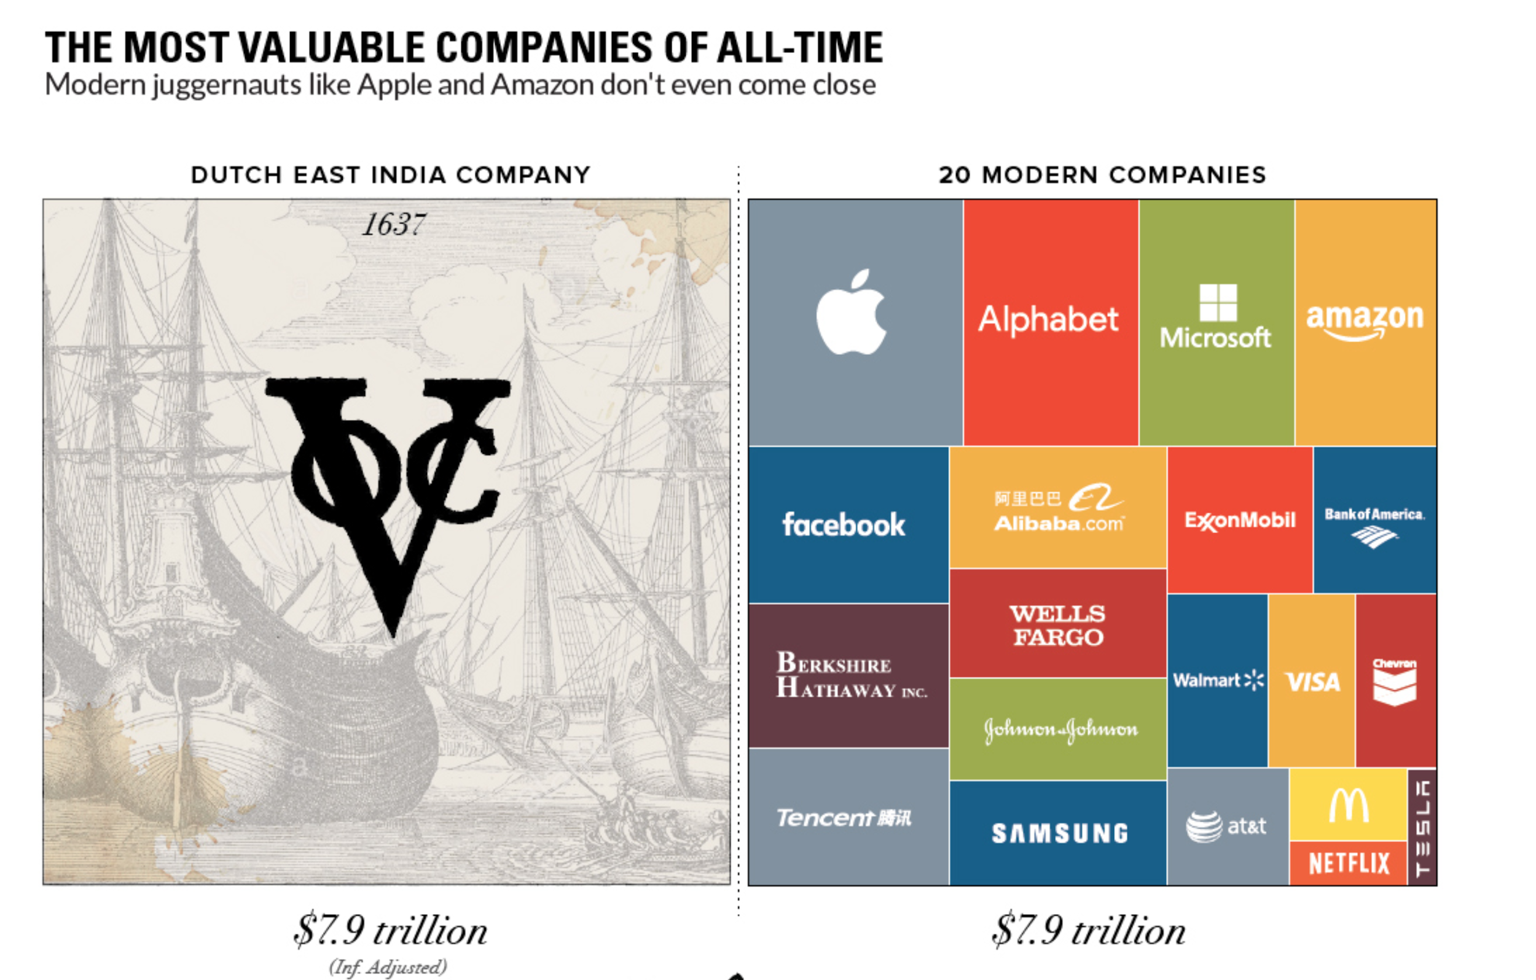
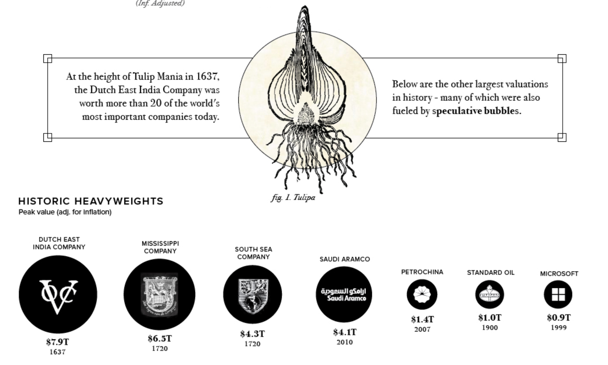
MARKET BUBBLES
https://www.visualcapitalist.com/most-valuable-companies-all-time/
Belief | Believer | Philosophy | Ancient | Analysis | Technician | Strategy
 |  |  | Old |  | Fundamentalist
 |  |  | Modern |  | Portfolio Theorist
 | Non-Believer |  | New |  | Behavioralist

Slide 15
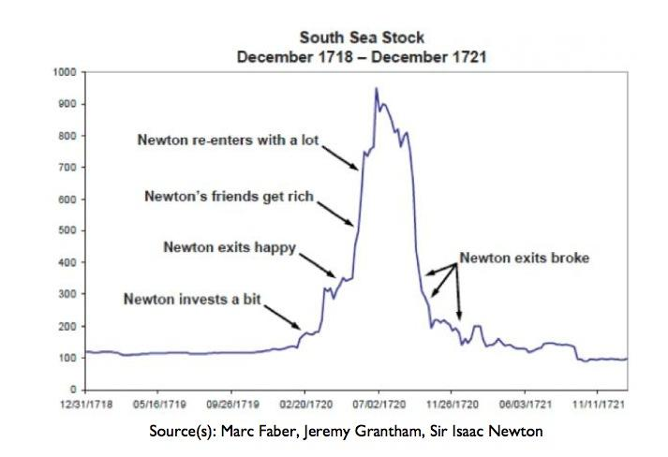
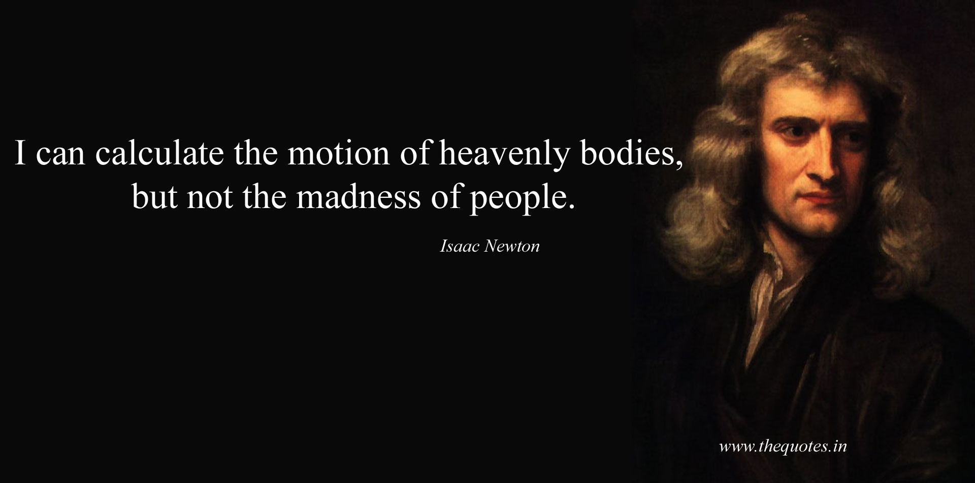
SOUTH SEA AND SIR. ISAAC NEWTOWN
Investment or Speculation
Belief | Believer | Philosophy | Ancient | Analysis | Technician | Strategy
 |  |  | Old |  | Fundamentalist
 |  |  | Modern |  | Portfolio Theorist
 | Non-Believer |  | New |  | Behavioralist

Slide 16
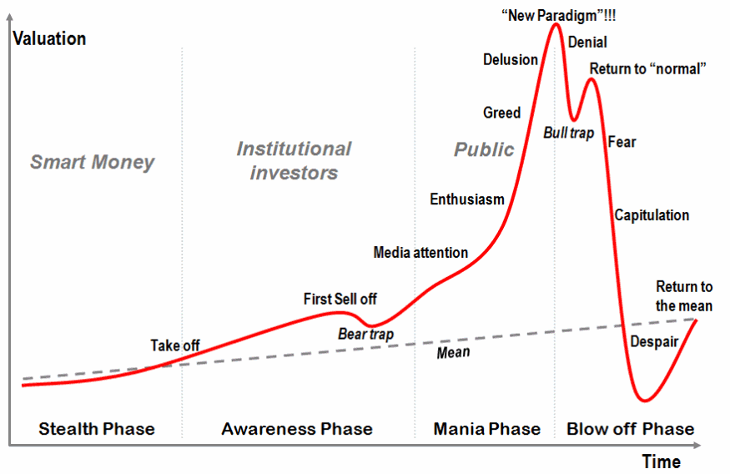
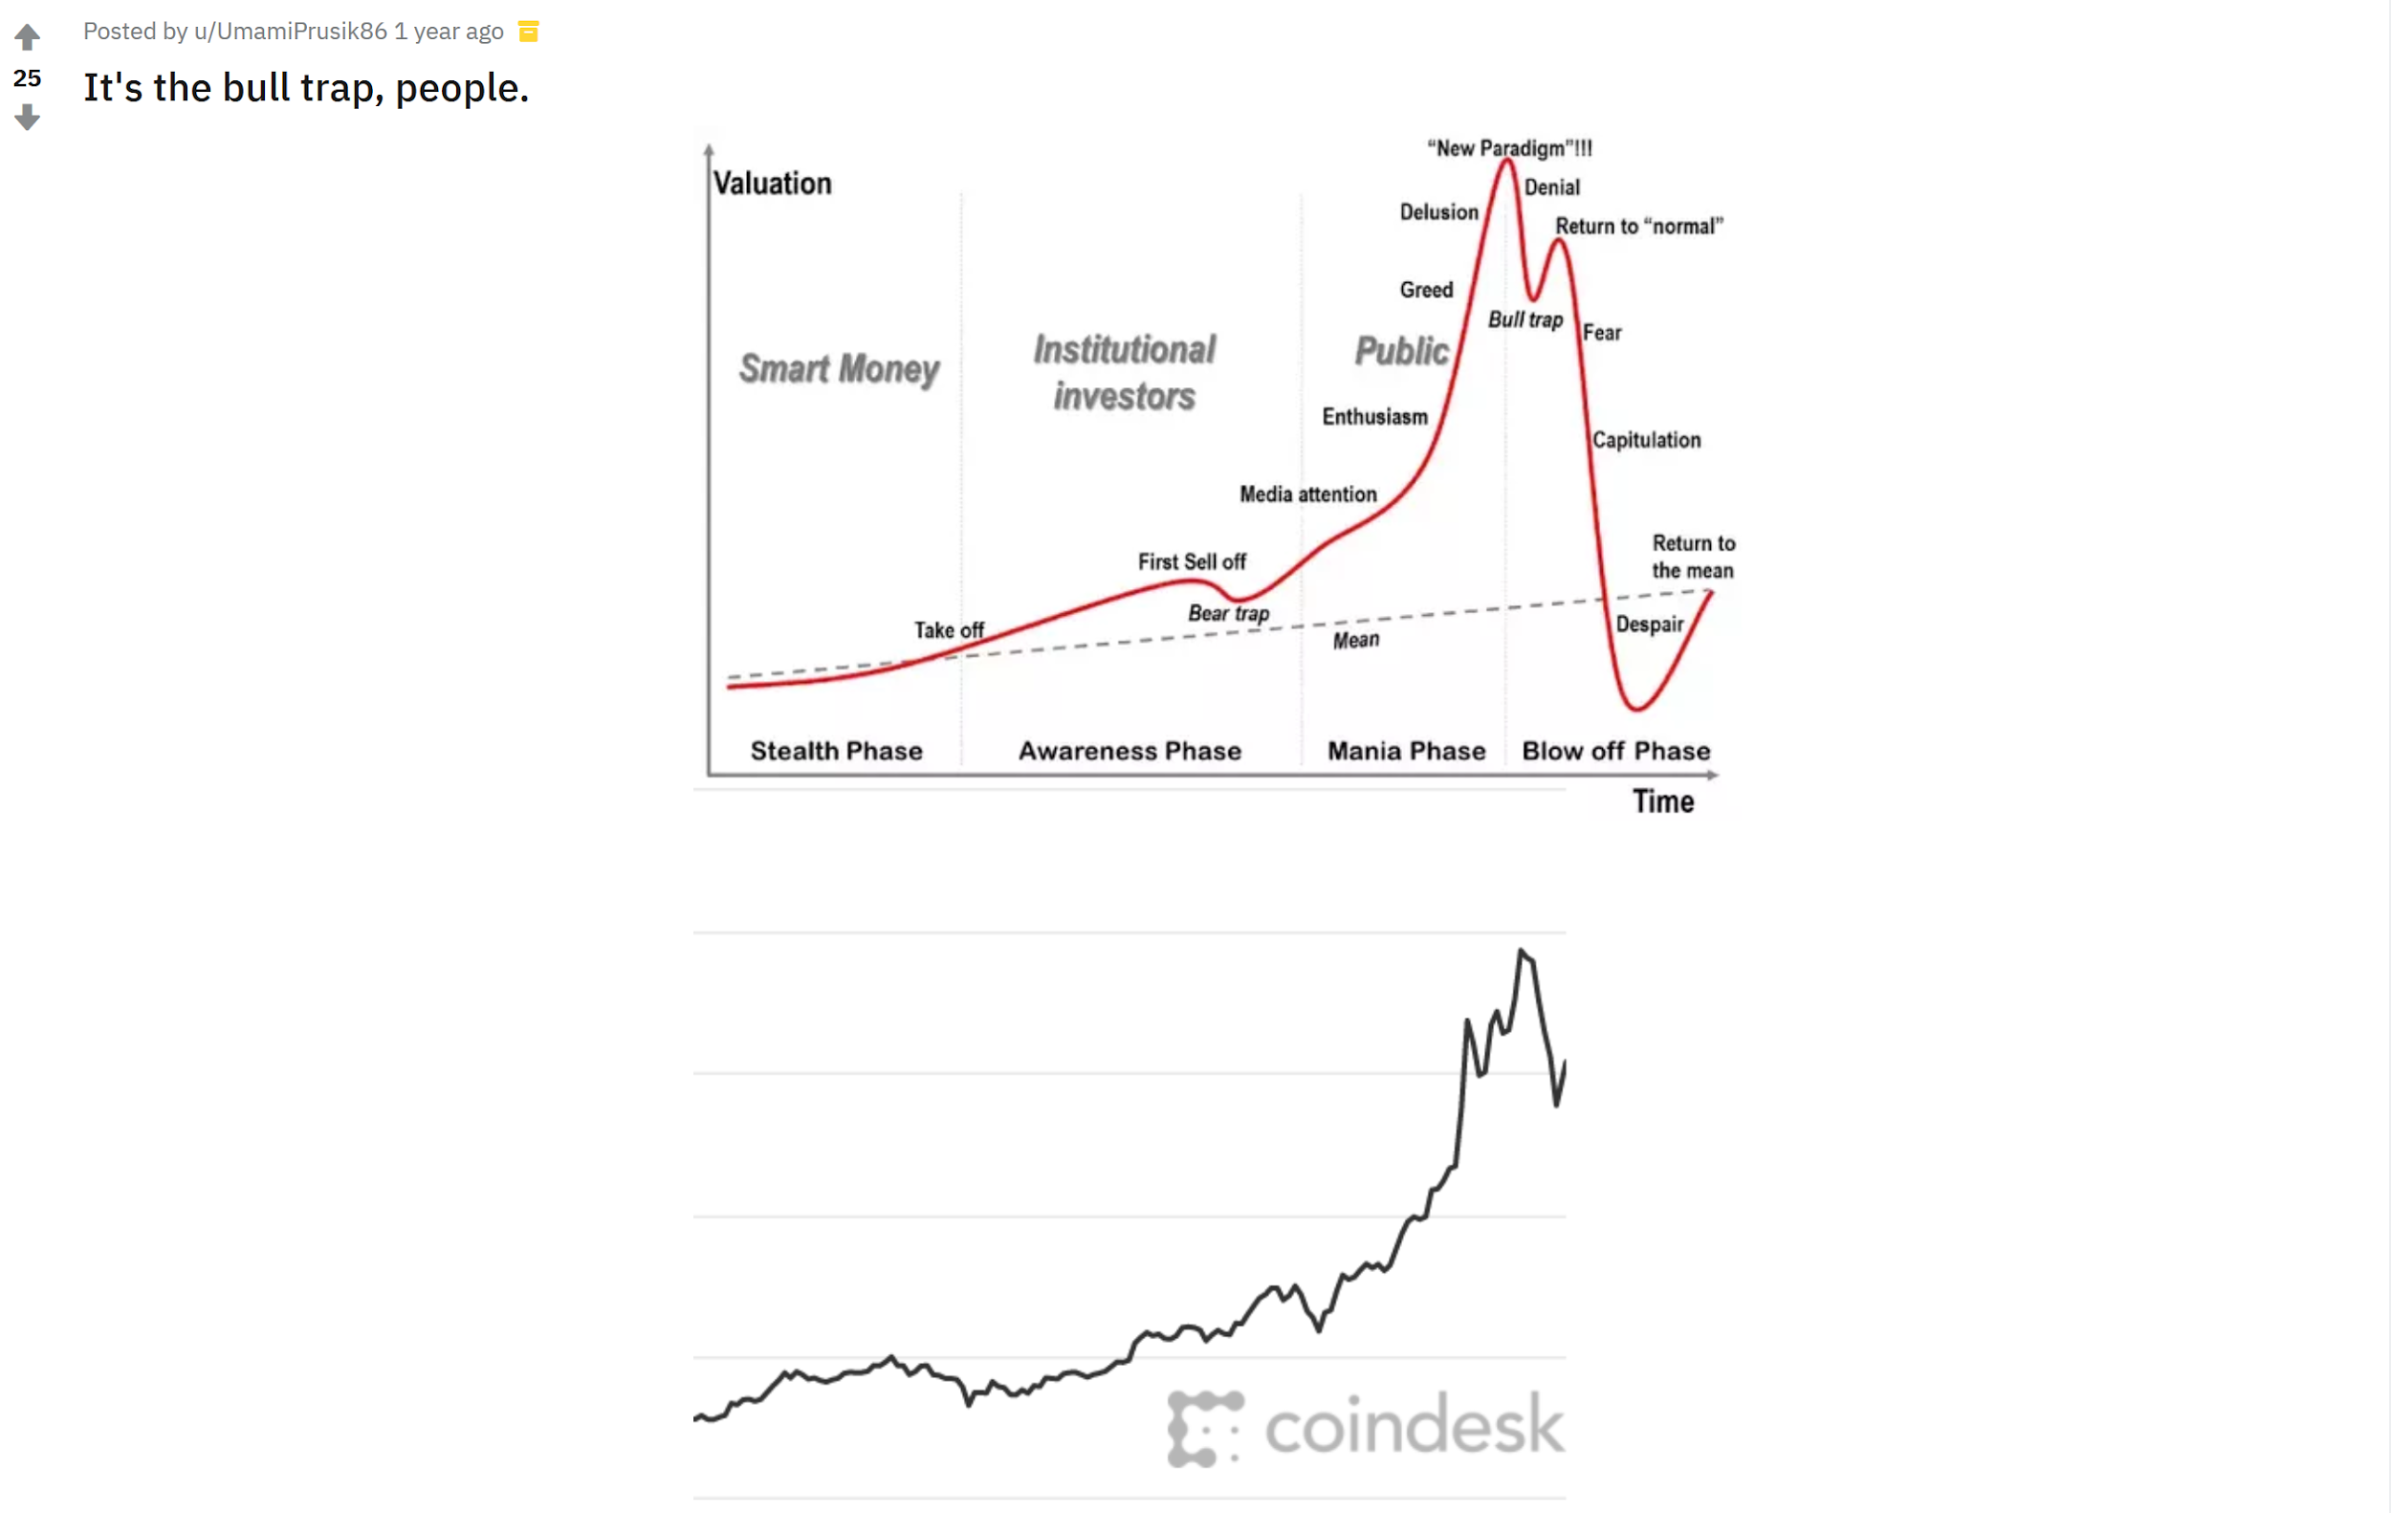
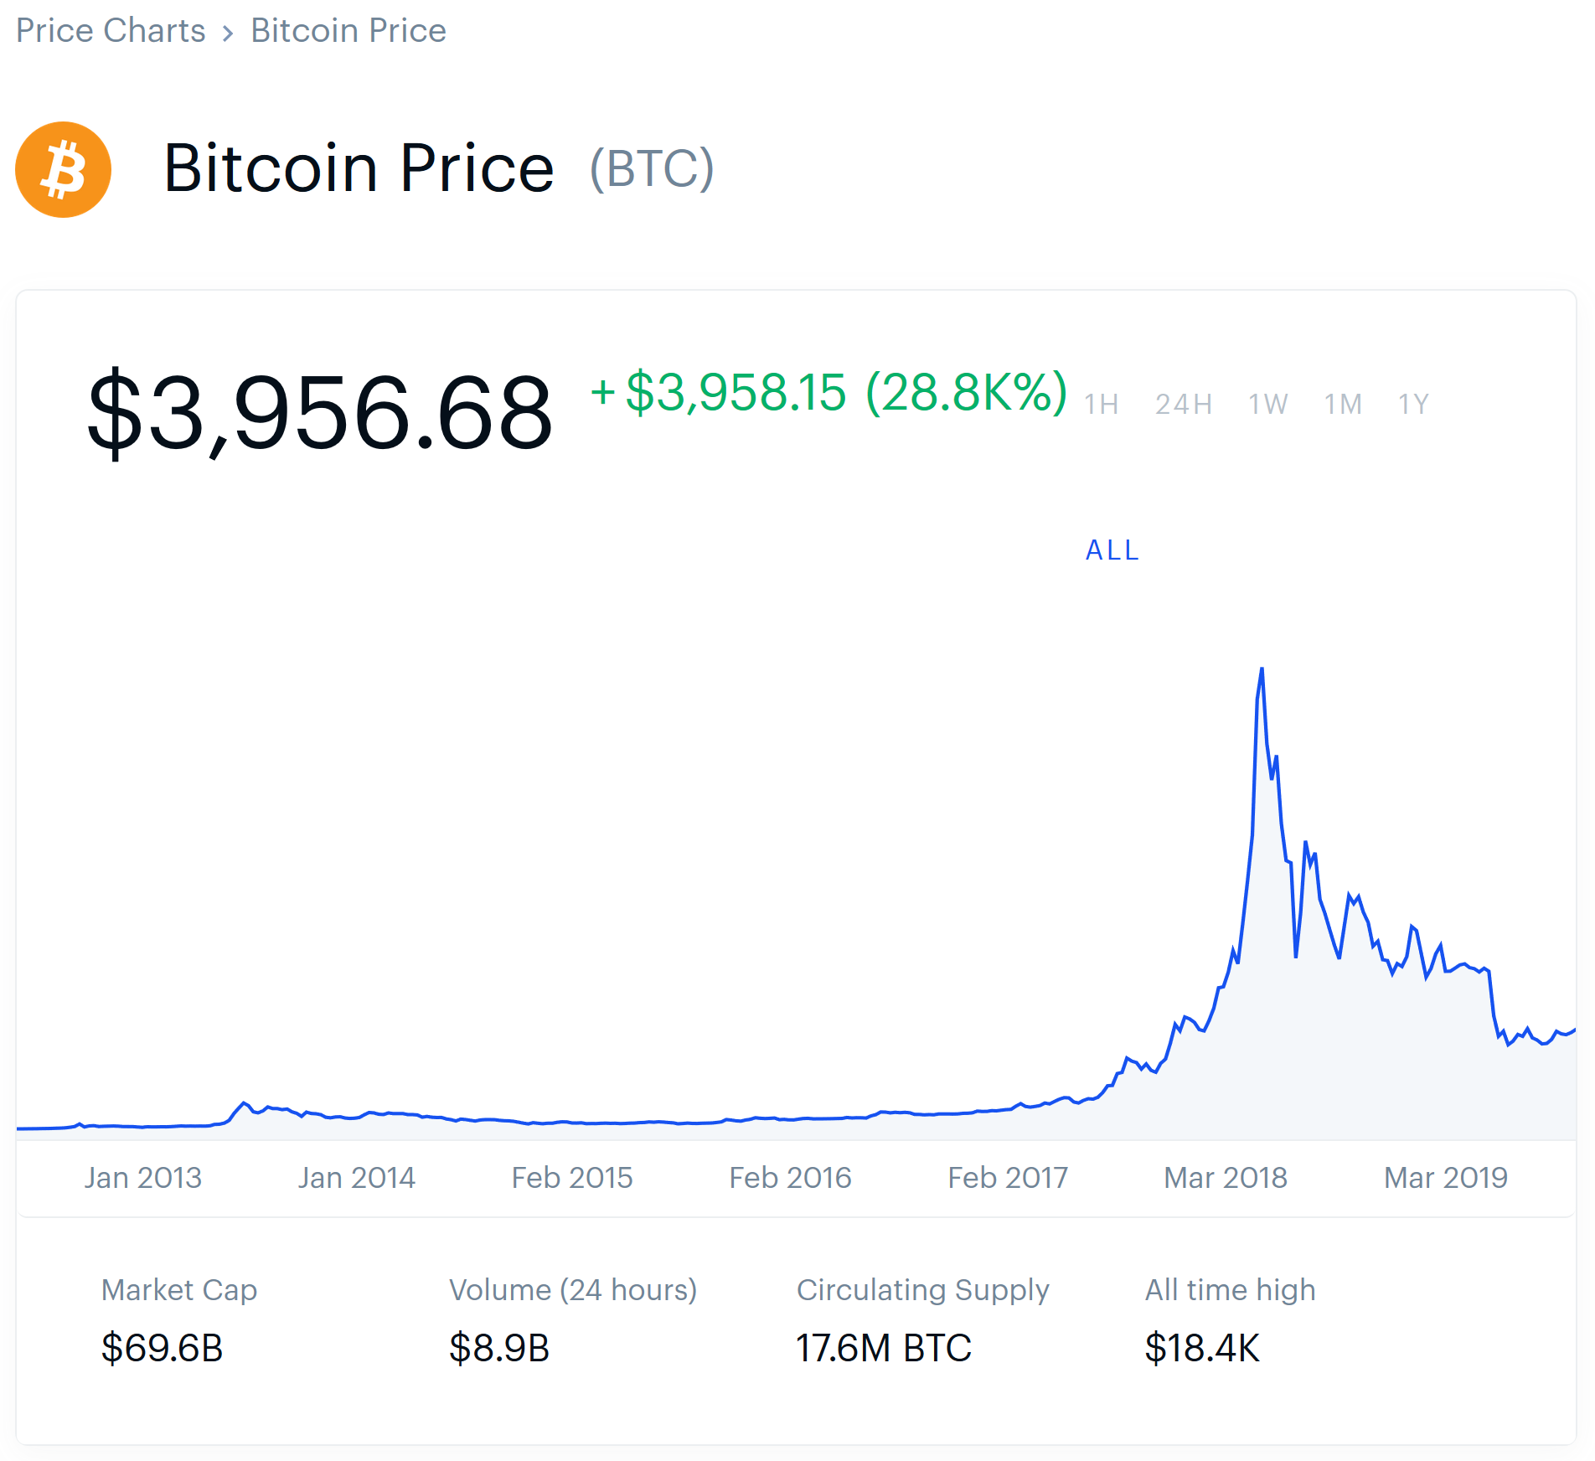
CRYPTOCURRENCY BUBBLE?
Jean-Paul Rodrigue
phases of a bubble (2008)
Source:
https://www.reddit.com/r/Bitcoin/comments/7lp6fc/its_the_bull_trap_people/
https://www.coinbase.com/price/bitcoin
Belief | Believer | Philosophy | Ancient | Analysis | Technician | Strategy
 |  |  | Old |  | Fundamentalist
 |  |  | Modern |  | Portfolio Theorist
 | Non-Believer |  | New |  | Behavioralist

Slide 17
OLD FINANCE - EARLY DEVELOPMENT OF ECONOMIC THEORIES
Adam Smith
The Wealth of Nations (1776)
Self-interested, Rational Individual Assumption
Absolute Advantage
David Ricardo
On the Principles of Political Economy and Taxation (1817)
Value theory
John Stuart Mill
Essays on some unsettled questions of political economy (1844)
Comparative Advantage
Alfred Marshall
Principles of Economics (1890)
Neoclassical Economics
Marginalist Revolution
Belief | Believer | Philosophy | Ancient | Analysis | Technician | Strategy
 |  |  | Old |  | Fundamentalist
 |  |  | Modern |  | Portfolio Theorist
 | Non-Believer |  | New |  | Behavioralist

Slide 18
OLD FINANCE - APPROACHES
Graham, Dodd and Cottle
Security Analysis (1934) (1962)
Anticipation Approach
Relative Value Approach
Intrinsic Value Approach
Margin of safety
“Ignore Mr. Market’s emotional issue and focus on the long-run”
John Keynes
The General Theory of Employment, Interest and Money (1936)(1964)
Anticipation Approach
“In the long run we are all dead.”
“Markets can remain irrational longer than you can remain solvent”
(Misattributed) “It is better to be vaguely right than exactly wrong.” - Carveth Read (1898)
Belief | Believer | Philosophy | Ancient | Analysis | Technician | Strategy
 |  |  | Old |  | Fundamentalist
 |  |  | Modern |  | Portfolio Theorist
 | Non-Believer |  | New |  | Behavioralist

Slide 19
OLD FINANCE - PRACTICES
Philip Fisher
Common stocks and uncommon profits (1958)
the best time to sell a stock is "almost never“
Warren Buffett
Quotes and Misquotes
“I’d be a bum on the street with a tin cup, if the market were always efficient.”
“Our favorite holding period is forever”
Not buying a stock but Investing in a business
Vahan Janjigian*
Even Buffett isn’t perfect – What You Can and Can’t Learn from the World’s Greatest Investor (2008)
Average investors should “never marry a stock.”
Belief | Believer | Philosophy | Ancient | Analysis | Technician | Strategy
 |  |  | Old |  | Fundamentalist
 |  |  | Modern |  | Portfolio Theorist
 | Non-Believer |  | New |  | Behavioralist
Notes:
*There is an old adage on Wall Street: “Never marry a stock.” Buffett marries business, while others can only “date stocks”. The difference, suggested by Vahan Janjigian (2008) is “all about control”. He suggests average investors can’t even have influences on a company like Buffett. They “simply can’t afford” and “not worth to” become a business buyer. They can only choose to become stock buyers (Ch. 4):
Buffett may object, but the fact is that the average investor must think more like a stock buyer than a business buyer. … The vast majority of investors do not have the resources available to marry stocks. They can only afford to date their investments. Buffett may brag that he has no exit strategy, but the average investor cannot afford to lock himself or herself into a stock forever—especially one that is providing only meager returns.
Thus, Janjigian concludes that “Buffett may correctly believe he is marrying the businesses he buys, but marrying stocks is simply not an appropriate strategy for everyone.” When an average investor is buying stock, he can fantasize but never actually believe that he is investing like Buffett. He continues:
A stock buyer knows that if a stock is selling for less than intrinsic value, it becomes a clear candidate for purchase. Even Buffett would agree with this. However, those who buy stocks rather than businesses are also thinking about selling. Recall that Buffett has no exit strategy. To a stock buyer, however, getting out is as important as getting in. Stock buyers know that if stocks can become undervalued, they can also become overvalued. They know that if it makes sense to buy undervalued stocks, then it must also make sense to sell overvalued ones. Buffett knows this, too. But Buffett prefers to get married. He does not like to sell.

Slide 20
MODERN FINANCE – MATHEMATICAL ANALYSIS
Irving Fisher*
Mathematical Investigations in the Theory of Value and Prices (1892)
The Theory of Interest, as Determined by Impatience to Spend Income and Opportunity to Invest It (1930)
Louis Bachelier*
The Theory of Speculation (1900)
Paul Samuelson*
Foundations of Economic Analysis (1947)
Belief | Believer | Philosophy | Ancient | Analysis | Technician | Strategy
 |  |  | Old |  | Fundamentalist
 |  |  | Modern |  | Portfolio Theorist
 | Non-Believer |  | New |  | Behavioralist
Notes:
*As Yale professor emeritus, Irving Fisher was famous for his comment on the then stock market price, which he described to be "reached what looks like a permanently high plateau.“ nine days before the 1929 crash. Despite that, he’s still considered "the greatest economist the United States has ever produced"
*Louis Bachelier, first person to mathematically model of Brownian motion and used it to value stock options.
*Paul Samuelson, significant contributor to the EMH, the first American to win the Nobel Prize in Economics, made introducing mathematical models into economic theories a wide practice after the 1947 publication of Foundations of Economic Analysis.

Slide 21
MODERN FINANCE - HYPOTHESES
Jules Regnault
Calcul des Chances et Philosophie de la Bourse (1863) (RWH)
Eugen Fama
The Behavior of Stock Market Prices (1965) (RWH)
Efficient Capital Markets: A Review of Theory and Empirical Work (1970) (EMH)
John Muth
Rational Expectations and the Theory of Price Movements (1961) (REH)
Burton MalKiel
A Random Walk Down Wall Street (1973) (RWH)
Belief | Believer | Philosophy | Ancient | Analysis | Technician | Strategy
 |  |  | Old |  | Fundamentalist
 |  |  | Modern |  | Portfolio Theorist
 | Non-Believer |  | New |  | Behavioralist

Slide 22
MODERN FINANCE – ASSETS PRICING
Harry Markowitz (1950s)
Diversification, mean-variance portfolio optimization model
Jack Treynor (1961, 1962), William F. Sharpe (1964), John Lintner (1965), Jan Mossin (1966), Michael Jensen (1968), Fischer Black (1972), etc.
Capital Assets Pricing Model (CAPM)
Treynor Ratio, Sharpe Ratio, Jensen's alpha etc.
Stephen Ross (1976)
Arbitrage Pricing Theory (APT)
Fischer Black, Myron Scholes(1973), and Later, Robert Merton
Contingent claims pricing models (BSM Model)
Belief | Believer | Philosophy | Ancient | Analysis | Technician | Strategy
 |  |  | Old |  | Fundamentalist
 |  |  | Modern |  | Portfolio Theorist
 | Non-Believer |  | New |  | Behavioralist

Slide 23
MODERN FINANCE - CORPORATE FINANCE
Franco Modigliani and Merton Miller
MMI and MMII* (1958)
Capital-Structure Irrelevance, tax shield and WACC
Alan Kraus and Robert Litzenberger
trade-off theory of capital structure (1973)
cost of financial distress
Belief | Believer | Philosophy | Ancient | Analysis | Technician | Strategy
 |  |  | Old |  | Fundamentalist
 |  |  | Modern |  | Portfolio Theorist
 | Non-Believer |  | New |  | Behavioralist
Notes:
*https://www.investopedia.com/terms/m/modigliani-millertheorem.asp

Slide 24
MATHEMATICAL MODEL EXAMPLES
Utility functions under REH in the CAPM framework
The return of a (well-diversified) portfolio under CAPM (a one factor model)
The return of a (Well-diversified) portfolio under multifactor model with APT
Black-Scholes equation and formulas
The Greeks
Etc.
Belief | Believer | Philosophy | Ancient | Analysis | Technician | Strategy
 |  |  | Old |  | Fundamentalist
 |  |  | Modern |  | Portfolio Theorist
 | Non-Believer |  | New |  | Behavioralist

Slide 25
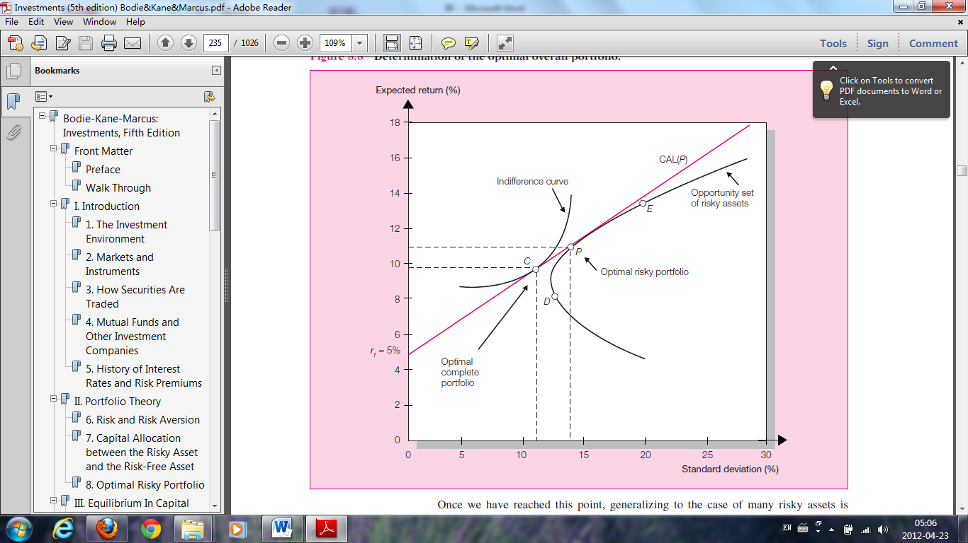
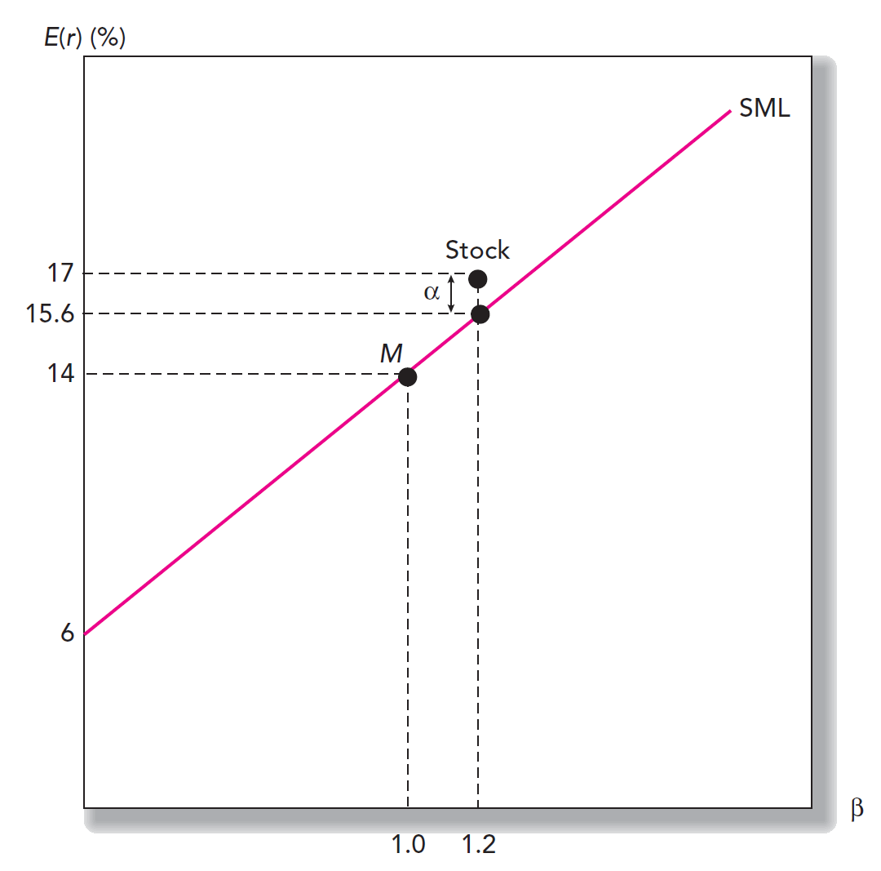
CAPM
Source: Bodis, Z., Kane, A., & Marcus, A. (2009). Investments (8th ed.). New York: McGraw-Hill Irwin.
Belief | Believer | Philosophy | Ancient | Analysis | Technician | Strategy
 |  |  | Old |  | Fundamentalist
 |  |  | Modern |  | Portfolio Theorist
 | Non-Believer |  | New |  | Behavioralist

Slide 26
THE NORMAL ASSUMPTION
Bean machine*
Binomial distribution
Random walk
Brownian motion
Heat Equation
Belief | Believer | Philosophy | Ancient | Analysis | Technician | Strategy
 |  |  | Old |  | Fundamentalist
 |  |  | Modern |  | Portfolio Theorist
 | Non-Believer |  | New |  | Behavioralist
Notes:
https://en.wikipedia.org/wiki/Bean_machine

Slide 27
NEW FINANCE
Robert Haugen
The New Finance: Overreaction, Complexity, and Uniqueness (2004)
Market Psychology and Market Anomalies
Non-self-interested and Irrational Behaviors
Normative theories and Positive theories (Behavioral Economics)
Risk aversion
Risk loving, Risk Neutral, Risk averse
Regret aversion
Insurance and Lottery coexists
Belief | Believer | Philosophy | Ancient | Analysis | Technician | Strategy
 |  |  | Old |  | Fundamentalist
 |  |  | Modern |  | Portfolio Theorist
 | Non-Believer |  | New |  | Behavioralist

Slide 28
BEHAVIORAL FINANCE
Early development with Ancient Finance
Market Anomalies, Bubbles and Financial Crises
Amos Tversky and Daniel Kahneman
Judgment Under Uncertainty: Heuristics and Biases (1974)
Prospect theory (1979)
Hersh Shefrin
Beyond Greed and Fear: Understanding Behavioral Finance and the Psychology of Investing (2002)
heuristic-driven bias
frame dependence
inefficient markets
Dan Ariely
Predictably Irrational (2008)
Belief | Believer | Philosophy | Ancient | Analysis | Technician | Strategy
 |  |  | Old |  | Fundamentalist
 |  |  | Modern |  | Portfolio Theorist
 | Non-Believer |  | New |  | Behavioralist

Slide 29
BEHAVIORAL BIAS
Cognitive error*
Definition: “Cognitive errors stem from basic statistical, information-processing, or memory errors; cognitive errors typically result from faulty reasoning. “ (CFA Institute)
Examples: Confirmation Bias, Gamblers’ Fallacy, Mental Accounting, etc.
Emotional bias*
Definition: “Emotional biases stem from impulse or intuition; emotional biases tend to result from reasoning influenced by feelings.” (CFA Institute)
Examples: Loss-Aversion Bias, Overconfidence Bias, Endowment Bias, etc.
Belief | Believer | Philosophy | Ancient | Analysis | Technician | Strategy
 |  |  | Old |  | Fundamentalist
 |  |  | Modern |  | Portfolio Theorist
 | Non-Believer |  | New |  | Behavioralist
Notes:
*Source: https://www.investopedia.com/articles/investing/051613/behavioral-bias-cognitive-vs-emotional-bias-investing.asp
And https://www.cfainstitute.org/membership/professional-development/refresher-readings/2019/behavioral-biases-individuals

Slide 30
ANALYSIS
Technician
Fundamentalist
Portfolio Theorist
Behavioralist
Belief | Believer | Philosophy | Ancient | Analysis | Technician | Strategy
 |  |  | Old |  | Fundamentalist
 |  |  | Modern |  | Portfolio Theorist
 | Non-Believer |  | New |  | Behavioralist
Notes:
What do you believe?
Which Investment philosophy do you agree with?
Analysis is more of a web than a line or a tree

Slide 31
TECHNICAL ANALYSIS
Charles Dow and Edward Jones
DJIA (1896)
William Gann*
Speculation A Profitable Profession (1910)
Tunnel Thru The Air (1927)
The Magic Word (1950)
Ralph Elliott
The Wave Principle (1938)
Nature's Law – The Secret of the Universe (1946)
Belief | Believer | Philosophy | Ancient | Analysis | Technician | Strategy
 |  |  | Old |  | Fundamentalist
 |  |  | Modern |  | Portfolio Theorist
 | Non-Believer |  | New |  | Behavioralist
Notes:
*The name of his book is quite mythical:
1908 – A $130 account increased to $12,000 in 30 days
1923 – A $973 account increased to $30,000 in 60 days.
1933 – 479 trades were made with 422 being profitable - an accuracy of 88% and 4000% profit.
1946 – A 3-month net profits of $13,000 from starting capital of $4500 – a 400% profit.

Slide 32
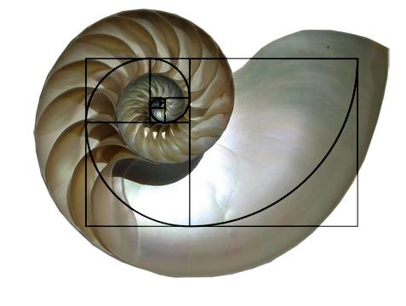
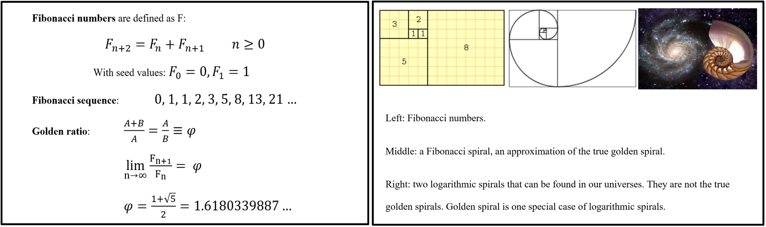
THE COMMON MISCONCEPTION
WRONG
Picture Credit: Wikipedia.org
Belief | Believer | Philosophy | Ancient | Analysis | Technician | Strategy
 |  |  | Old |  | Fundamentalist
 |  |  | Modern |  | Portfolio Theorist
 | Non-Believer |  | New |  | Behavioralist

Slide 33
TECHNICAL ANALYSIS CON’T
Louise McWhirter
Astrology and Stock Market Forecasting (1977)
Welles Wilder
New Concepts in Technical Trading Systems (1978)
RSI, DMI, ATR, MOM, ADX, SAR,…
The Adam Theory of Markets or What Matters is Profit (1987)
None of them works, follow the old saying “The trend is your friend.”
John Bollinger
Bollinger Bands ® (1980s)
Nison Steve
Japanese Candlestick Charting Techniques (1991)
Martin Schwartz*
Pit Bull: Lessons from Wall Street's Champion Day Trader (1999)
Belief | Believer | Philosophy | Ancient | Analysis | Technician | Strategy
 |  |  | Old |  | Fundamentalist
 |  |  | Modern |  | Portfolio Theorist
 | Non-Believer |  | New |  | Behavioralist
Notes:
*A more recent version of someone made a fortune by using technical analysis is Martin Schwartz, an MBA from Columbia University and later became a Wall Street trader. He received national attention when he won the U.S. Investing Championship in 1984. In his first full year as an independent trader he made $600,000 and a year later earned $1.2 million. His exact methods were not reviewed in the book.

Slide 34
FUNDAMENTAL ANALYSIS
Macro
Market, Industry, Political, Economic, Sociocultural, Technological, Legal, Environmental, etc.
E.g.: PESTLE, “Porter's Five Forces”
Micro
Financial Reports, Market metrics, Analyst’s Reports, Credit Rating, Corporate Governance, etc.
E.g.: “the Big four”
Company strategies and Competitive advantage
E.g.: Porter's generic strategies, SWOT
Caution: “Cook the books”, OBS & SPV, Asymmetric Information*, Principal-Agent Problem* and Moral Hazard*.
Sarbanes-Oxley Act (SOX) (Enron, WorldCom)
Howard Schilit - Financial Shenanigans: How to Detect Accounting Gimmicks and Fraud in Financial Reports (1993)
Belief | Believer | Philosophy | Ancient | Analysis | Technician | Strategy
 |  |  | Old |  | Fundamentalist
 |  |  | Modern |  | Portfolio Theorist
 | Non-Believer |  | New |  | Behavioralist
Notes:
*Example: Monty Hall Problem
*AKA Agency dilemma. It exists in circumstances where agents are motivated to act in their own best interests, which are contrary to those of their principals.
*In economics, moral hazard occurs when someone increases their exposure to risk when insured, especially when a person takes more risks because someone else bears the cost of those risks.

Slide 35
PORTER'S FIVE FORCES
Threat of New Entrants
Bargaining power of Suppliers
Competitive Rivalry
Bargaining power of Customers
Complementors
Threat of Substitutes
Michael Porter* (1979)
Belief | Believer | Philosophy | Ancient | Analysis | Technician | Strategy
 |  |  | Old |  | Fundamentalist
 |  |  | Modern |  | Portfolio Theorist
 | Non-Believer |  | New |  | Behavioralist
Notes:
*https://en.wikipedia.org/wiki/Porter%27s_five_forces_analysis

Slide 36
THE BIG FOUR
Income Statement
Balance Sheet
Cash Flow Statement
Statement of Shareholder Equities
Notes
Belief | Believer | Philosophy | Ancient | Analysis | Technician | Strategy
 |  |  | Old |  | Fundamentalist
 |  |  | Modern |  | Portfolio Theorist
 | Non-Believer |  | New |  | Behavioralist

Slide 37
VALUATION
Valuation methods*
Absolute Valuation:
DCF
Cost Approach
Ability to pay
liquidation value
EVA and MVA
Relative Valuation:
Comparable (ratios and market metrics)
Precedent Transactions
Assumptions
Sensitivity Analysis
Belief | Believer | Philosophy | Ancient | Analysis | Technician | Strategy
 |  |  | Old |  | Fundamentalist
 |  |  | Modern |  | Portfolio Theorist
 | Non-Believer |  | New |  | Behavioralist
Notes:
*https://corporatefinanceinstitute.com/resources/knowledge/valuation/valuation-methods/

Slide 38
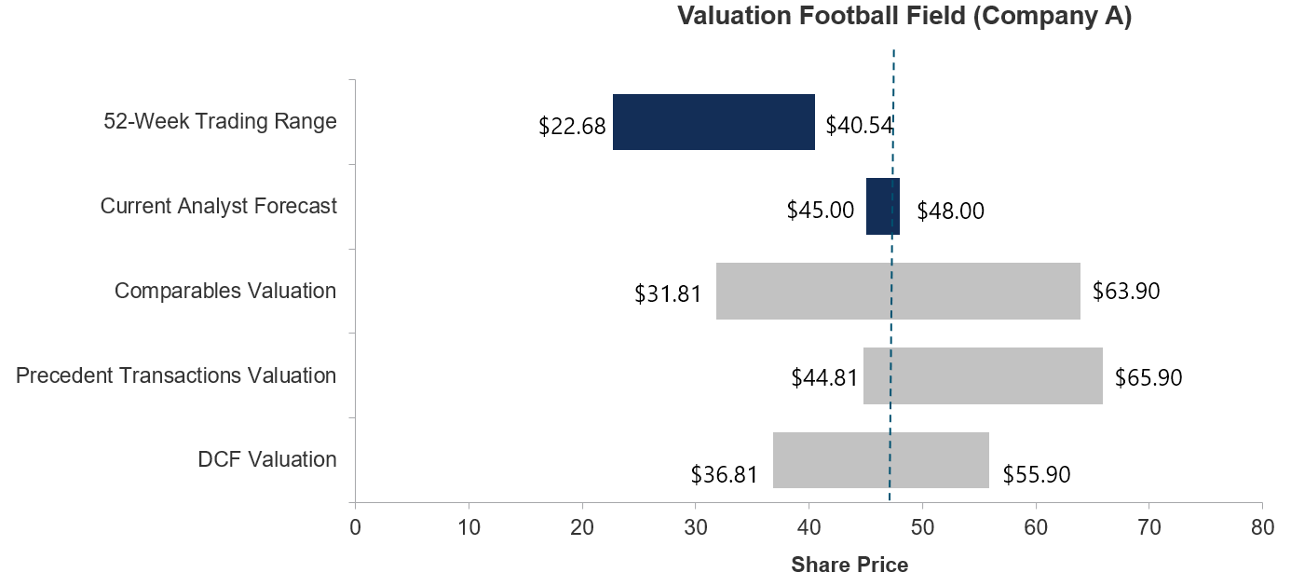
FOOTBALL FIELD CHART
Source: corporatefinanceinstitute.com
Belief | Believer | Philosophy | Ancient | Analysis | Technician | Strategy
 |  |  | Old |  | Fundamentalist
 |  |  | Modern |  | Portfolio Theorist
 | Non-Believer |  | New |  | Behavioralist

Slide 39
RISKS
Return and Risk tradeoffs
Coefficient “A” of the utility curve
Risk Aversion Assumption
Risk Type
Market, Credit, Liquidity, Operational, Model, etc
Risk Measure
Qualitative, Quantitative, Quantified Qualitative
Risk Management and Control
Black Swan and Gray Rhino
Example
LTCM
Belief | Believer | Philosophy | Ancient | Analysis | Technician | Strategy
 |  |  | Old |  | Fundamentalist
 |  |  | Modern |  | Portfolio Theorist
 | Non-Believer |  | New |  | Behavioralist

Slide 40
THE BASICS OF A FINANCIAL ANALYSIS REPORT
Executive Summary
Company Overview
Investment Thesis
Valuation
Key Risks
Other Considerations
The Bottom Line
Source: https://www.investopedia.com/articles/investing/032113/basics-financial-analysis-report.asp
Belief | Believer | Philosophy | Ancient | Analysis | Technician | Strategy
 |  |  | Old |  | Fundamentalist
 |  |  | Modern |  | Portfolio Theorist
 | Non-Believer |  | New |  | Behavioralist

Slide 41
PORTFOLIO MANAGEMENT
Active vs. Passive (e.g. Index Funds, ETFs)
Pricing Models (e.g. CAPM, APT, BSM)
Trading Strategies (e.g. Risk-Factors(Beta), Statistical Arbitrage, Pair Trading)
Return Generation (e.g. Alpha)
Risk Measures (e.g. VaR, ES)
Financial Engineering/ Quant (e.g. the Greeks(Delta-Gamma Hedging))
Economics and Econometrics (e.g. Cross Sectional, Time Series, Panel)
Belief | Believer | Philosophy | Ancient | Analysis | Technician | Strategy
 |  |  | Old |  | Fundamentalist
 |  |  | Modern |  | Portfolio Theorist
 | Non-Believer |  | New |  | Behavioralist

Slide 42
SMART BETA AND ETF
Fama–French three-factor Model*
Market Minus Risk-free
High beta vs. Low beta/volatility?
Small Minus Large
Small cap vs. Large cap
High Minus Low
Value vs. Growth
Belief | Believer | Philosophy | Ancient | Analysis | Technician | Strategy
 |  |  | Old |  | Fundamentalist
 |  |  | Modern |  | Portfolio Theorist
 | Non-Believer |  | New |  | Behavioralist
Notes:
*http://mba.tuck.dartmouth.edu/pages/faculty/ken.french/data_library.html

Slide 43
ANALYSIS EXAMPLES
Industry Practice
Mutual Funds
https://www.td.com/ca/en/personal-banking/products/saving-investing/mutual-funds/td-mutual-funds/
Belief | Believer | Philosophy | Ancient | Analysis | Technician | Strategy
 |  |  | Old |  | Fundamentalist
 |  |  | Modern |  | Portfolio Theorist
 | Non-Believer |  | New |  | Behavioralist

Slide 44
BEHAVIORAL INVESTING
Eugen Fama
Market Efficiency, Long-Term Returns, and Behavioral Finance (1998)
Opponent of Behavioral finance
“inadequate quality of statistical research”
Robert Shiller*
Irrational Exuberance (2000) (2005)
Timely prediction of market crash
From Efficient Markets Theory to Behavioral Finance (2003)
“we do not expect such research to provide a method to make a lot of money off of”
Hersh Shefrin
Beyond Greed and Fear: Understanding Behavioral Finance and the Psychology of Investing (2002)
“not to use behavioral finance to make a killing.”
Behavioral Risk Management (2015)
“The most important risk management disasters in the preceding fifteen years all have psychological pitfalls at their root.”
Belief | Believer | Philosophy | Ancient | Analysis | Technician | Strategy
 |  |  | Old |  | Fundamentalist
 |  |  | Modern |  | Portfolio Theorist
 | Non-Believer |  | New |  | Behavioralist
Notes:
*Robert Shiller - Irrational Exuberance, become famous when being published the same month as the stock market peaked in March, 2000. He also gave early warning of the housing market bubble in the second edition of Irrational Exuberance in the 2005 with the bust of the bubble three years later, which eventually leads to world recession of 2008-2009.

Slide 45
THE FUTURE OF FINANCE?
Return/Profit generation perspective
Is there real life applications to make profit using psychology?
Minimum payment on credit cards
Market anomaly exploitation?
Risk control perspective
Belief | Believer | Philosophy | Ancient | Analysis | Technician | Strategy
 |  |  | Old |  | Fundamentalist
 |  |  | Modern |  | Portfolio Theorist
 | Non-Believer |  | New |  | Behavioralist

Slide 46
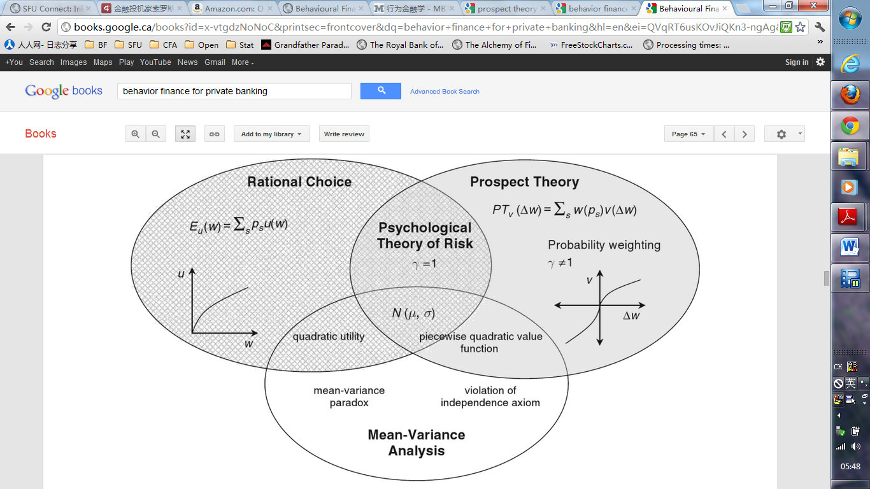
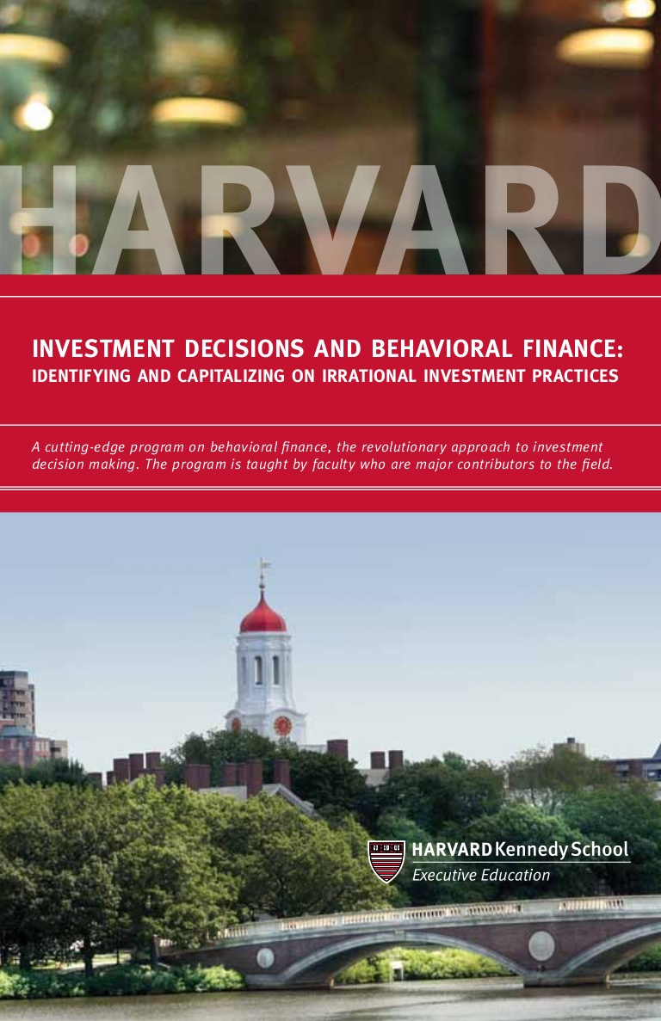
THE EXPERIMENTS ON FUTURE FINANCE
Source: Hens, T. & Bachmann K. (2008) Behavioral Finance for Private Banking, West Sussex: John Wiley & Sons, p. 65
Belief | Believer | Philosophy | Ancient | Analysis | Technician | Strategy
 |  |  | Old |  | Fundamentalist
 |  |  | Modern |  | Portfolio Theorist
 | Non-Believer |  | New |  | Behavioralist
Notes:
The flyer reads: Investment decisions and behavioral finance: Identifying and capitalizing on irrational investment practices: A cutting-edge program on behavioral finance, the revolutionary approach to investment decision making. The program is taught by faculty who are major contributors to the field.

Slide 47
POSSIBLE STRATEGIES FOR STOCKS
Trend Following
e.g. “Buy high, sell higher”, “The trend is your friend, until the end when it bends.”
Value Investing
e.g. “Buy low, sell high”, Margin of safety, Value vs. Growth, Buffett Quotes
Portfolio Management
e.g. Diversification, Benchmark or Absolute Return, Hedging risk, Seeking Alpha
Behavioral Approach
e.g. Reduce and eliminate behavioral bias, Anomalies Exploitation
Question: Momentum Investing?
Belief | Believer | Philosophy | Ancient | Analysis | Technician | Strategy
 |  |  | Old |  | Fundamentalist
 |  |  | Modern |  | Portfolio Theorist
 | Non-Believer |  | New |  | Behavioralist
Notes:
*Piece of thought: Turing test and the Chinese Room Argument, can AI really “understand” what we taught them? How can we really know if they “understand”? Or we just don’t really care.

Slide 48
THE NEW TREND – SYNTHESIS WITH DATA SCIENCE
All the fancy names
e.g. AI, ML, NN, DL
Current industry trend as to incorporate big data, and conduct various types of analyses to assist investment strategy formation.
e.g. Algorithm Trading
Artificial Intelligence
Machine Learning
Neural Network
Deep Learning
Belief | Believer | Philosophy | Ancient | Analysis | Technician | Strategy
 |  |  | Old |  | Fundamentalist
 |  |  | Modern |  | Portfolio Theorist
 | Non-Believer |  | New |  | Behavioralist

Slide 49
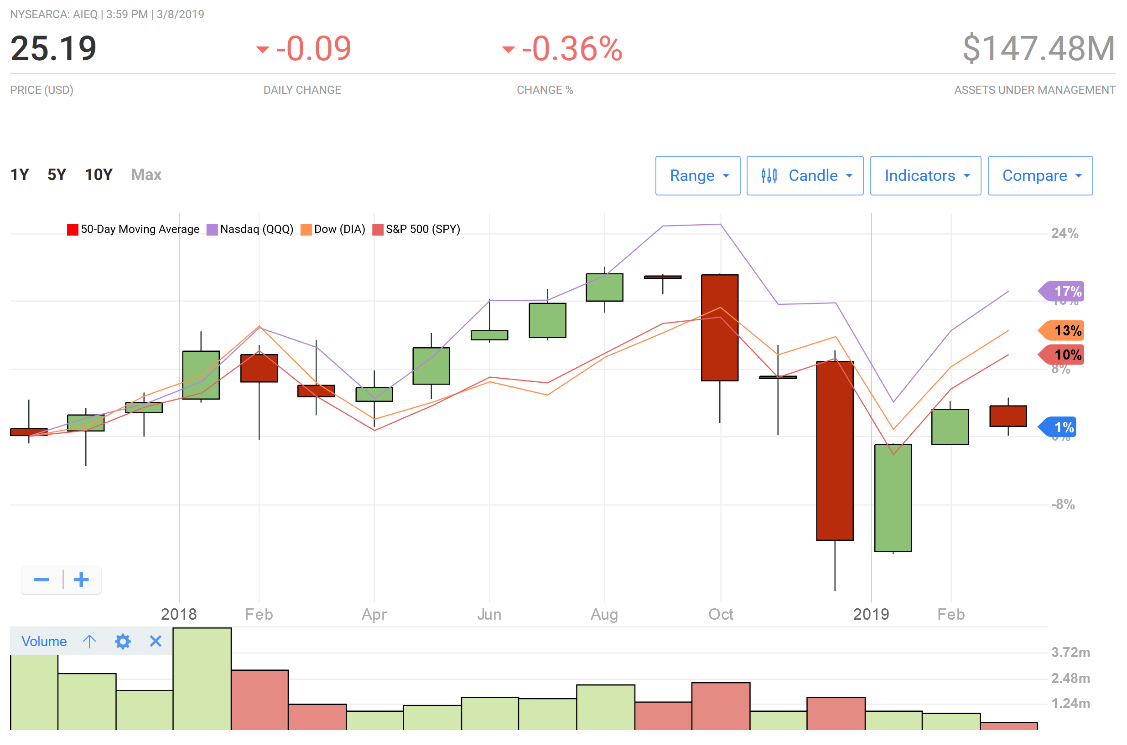
THE GAME’S ANSWER
AIEQ
EquBot: The AI Powered Equity ETF (AIEQ)
World's First AI-Run Global ETF Makes Its Own Managers Nervous
Chart Credit: https://money.usnews.com/funds/etfs/large-blend/ai-powered-equity-etf/aieq/interactive
Belief | Believer | Philosophy | Ancient | Analysis | Technician | Strategy
 |  |  | Old |  | Fundamentalist
 |  |  | Modern |  | Portfolio Theorist
 | Non-Believer |  | New |  | Behavioralist

Slide 50
MARKETS OTHER THAN THE EQUITY MARKET (OPTIONAL)
Bond Market
Term Structure of Interest
Level, Duration, Convexity
Option Adjusted Spread
Credit Spread
Commodities
Technical, Fundamental, Supply and Demand,
Derivatives
Pricing Models, VIX
Other Alternatives (Real Estates, Forex, Cryptocurrency, etc.)
Take a guess on their market sizes compare to the stock market?
Belief | Believer | Philosophy | Ancient | Analysis | Technician | Strategy
 |  |  | Old |  | Fundamentalist
 |  |  | Modern |  | Portfolio Theorist
 | Non-Believer |  | New |  | Behavioralist

Slide 51
BOND (OPTIONAL)
What “interest rate” are we talking about?
Federal Funds Rate, Overnight Target Rate, etc.
US Treasury Bills, Canadian Government Bond, European Sovereign Bond, etc.
LIBOR, OIS, SOFR, etc.
Prime Rate
All the other rates
Negative interest rates*
Type of Bonds
Zeroes, Coupons, Strips
Federal, Provincial, Municipal, Corporate
Embedded options (Callable, Putable, Convertible)
Secured with Collaterals, Ratings with Tranches
Belief | Believer | Philosophy | Ancient | Analysis | Technician | Strategy
 |  |  | Old |  | Fundamentalist
 |  |  | Modern |  | Portfolio Theorist
 | Non-Believer |  | New |  | Behavioralist
Notes:
*https://www.vox.com/2015/2/5/7981461/negative-interest-rates-europe?fbclid=IwAR0JAI9jWQzEO1BY-6-Ou3G_q0Zdgo3SmTwbJkC_BDZt3KsgNQ6mtneaC6k

Slide 52
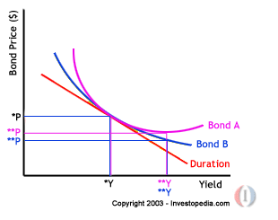
BOND EXAMPLES (OPTIONAL)
Classical Immunization Strategy
Barbell vs. Bullet trade-offs
Duration, Convexity and Key Rates
The trade-off of Theta
Arbitrage
Long-Term Capital Management (LTCM)
European Debt Crisis
Bond A has embedded Options?
Belief | Believer | Philosophy | Ancient | Analysis | Technician | Strategy
 |  |  | Old |  | Fundamentalist
 |  |  | Modern |  | Portfolio Theorist
 | Non-Believer |  | New |  | Behavioralist

Slide 53
COMMODITIES (OPTIONAL)
The New Gatsbys (Tamarkin, 1985, pp. 112-113). The story takes place at the Chicago Board of Trade:
Soybeans were sharply higher. There was a drought in the Illinois Soybean Belt. And unless it ended soon, there would be a severe shortage of Beans. … Suddenly a few drops of water slid down a window. “Look,” someone shouted, “rain!” More than 500 pairs of eyes shifted to the big windows. … Then came a steady trickle which turned into a steady downpour. It was raining in downtown Chicago.
Sell. Buy. Buy. Sell. The shouts cascaded from the traders' lips with a roar that matched the thunder outside. And the price of soybeans began to slowly move down. Then the price of soybeans broke like some tropic fever.
It was pouring in Chicago all right, but no one grows soybeans in Chicago. In the heart of the Soybean Belt, some 300 miles south of Chicago the sky was blue, sunny and very dry. But even if it wasn't raining on the soybean fields it was in the heads of the traders, and that is all that counts. To the market nothing matters unless the market reacts to it. The game is played with the mind and the emotions.
Belief | Believer | Philosophy | Ancient | Analysis | Technician | Strategy
 |  |  | Old |  | Fundamentalist
 |  |  | Modern |  | Portfolio Theorist
 | Non-Believer |  | New |  | Behavioralist

Slide 54
DERIVATIVES (OPTIONAL)
John Hull
Options, Futures, and Other Derivatives
Investopedia.com
https://www.investopedia.com/trading/options-strategies/
Belief | Believer | Philosophy | Ancient | Analysis | Technician | Strategy
 |  |  | Old |  | Fundamentalist
 |  |  | Modern |  | Portfolio Theorist
 | Non-Believer |  | New |  | Behavioralist

Slide 55
STORY TIME: CAUTIONS
Ex ante vs. Ex post
“Past performance is no guarantee of future results.”
The Morningstar’s tale of “How to become a millionaire?”
“Nothing is guaranteed”
The Airline stock’s tale of “How to become a millionaire?”
“Lies, damned lies, and statistics.”
Paradoxes
Simpson’s Paradox, Berkson's paradox, Bertrand paradox, Two Envelops Paradox, Raven Paradox, etc.
GIPS
Arithmetic vs. Geometric Returns
Time-weighted vs. Money-weighted Returns
Survivorship Bias
Termination Unobserved
Belief | Believer | Philosophy | Ancient | Analysis | Technician | Strategy
 |  |  | Old |  | Fundamentalist
 |  |  | Modern |  | Portfolio Theorist
 | Non-Believer |  | New |  | Behavioralist

Slide 56
CONCLUSION
Belief
Philosophy
Analysis
Strategy

Slide 57
Q&A
Missed some big names? e.g. George Soros*, Peter Lynch, etc.
Notes:
*George Soros does not believe in EMH. He also considers technical analysis “more of alchemy than science” and do not work well in an open system like the financial markets (Soros, 2000). Interesting enough, he did name his reflexivity theory “The Alchemy of Finance” in one of his book with the same title (Soros, 2003). He does not believe in fundamental analysis either. When explaining his reflexivity theory, he states: “I do not accept the proposition that stock prices are a passive reflection of underlying values, nor do I accept the proposition that the reflection tends to correspond to the underlying value.”

Slide 58
THANK YOU

